Slide 1
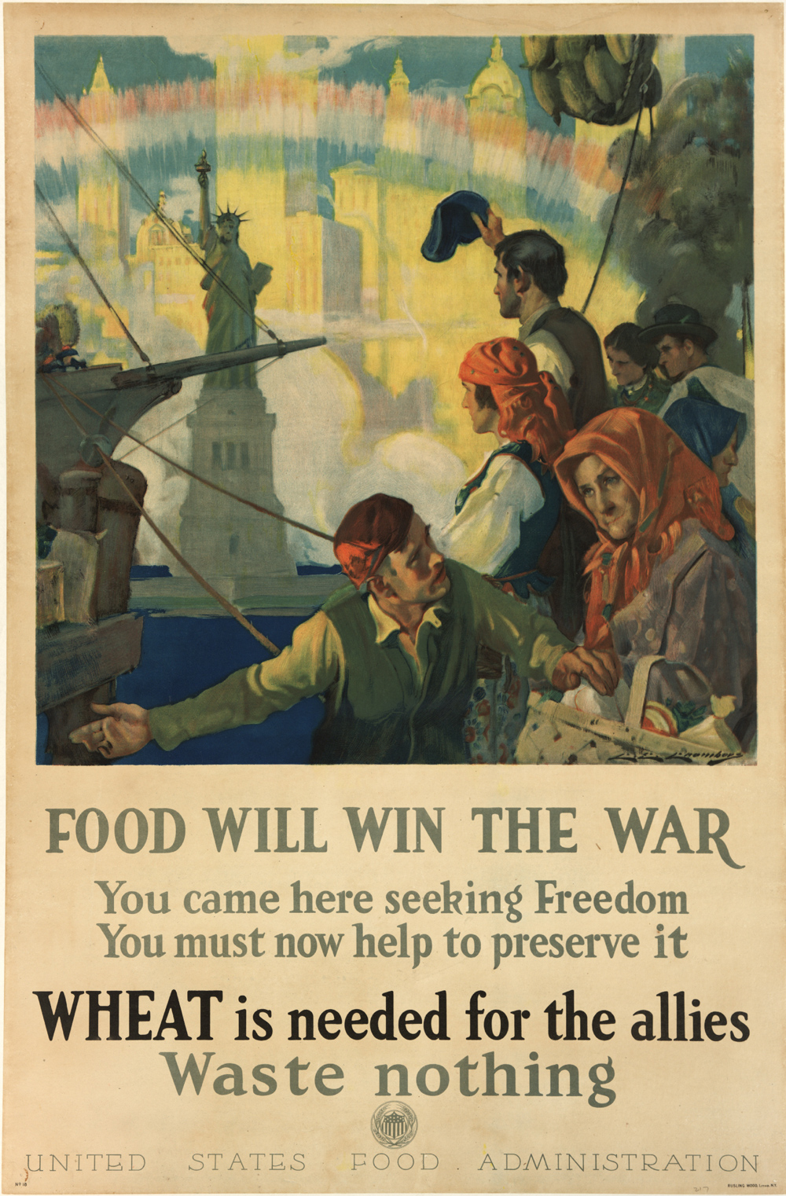
Food Will Win the War
Victory Gardens from World War I to Today

Slide 2
World War I
“Food Will Win the War”: All Americans urged to do their part

Slide 3
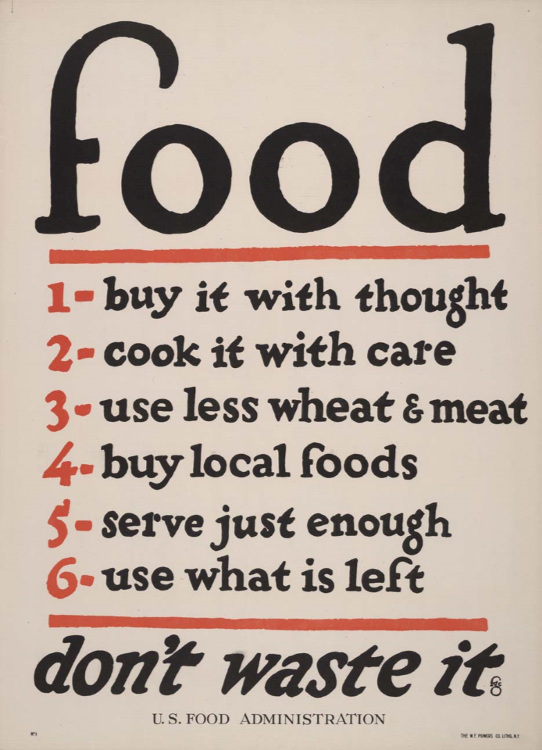
Notes:
Brief overview of Victory Gardens

Slide 4
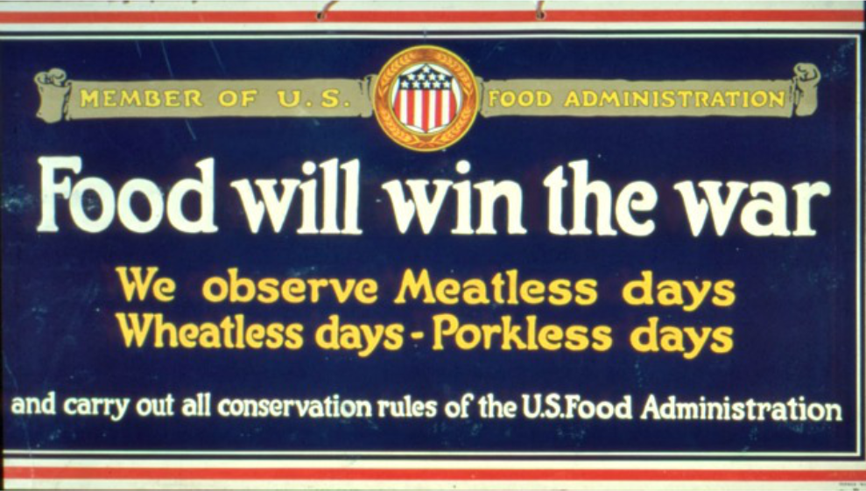
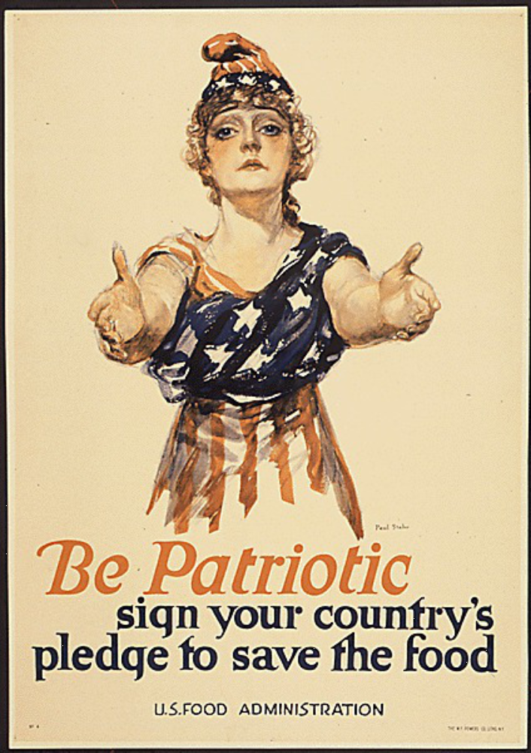
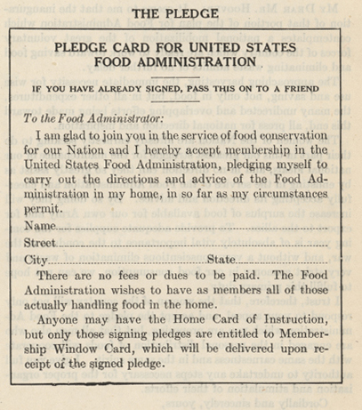
Notes:
Food pledge

Slide 5
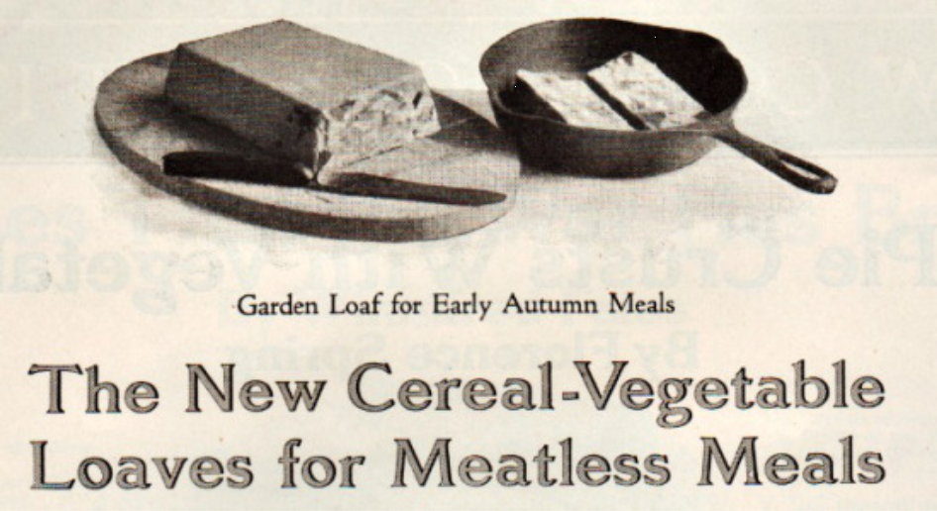
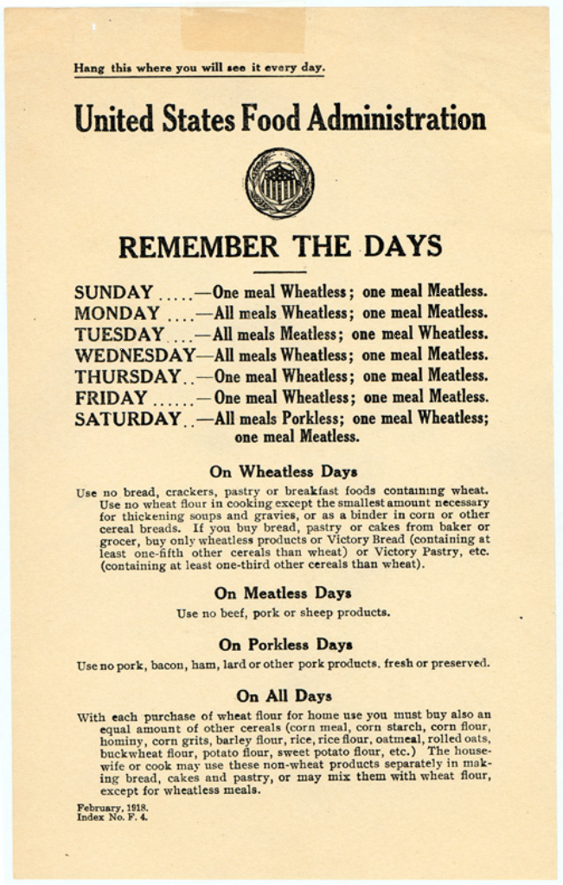
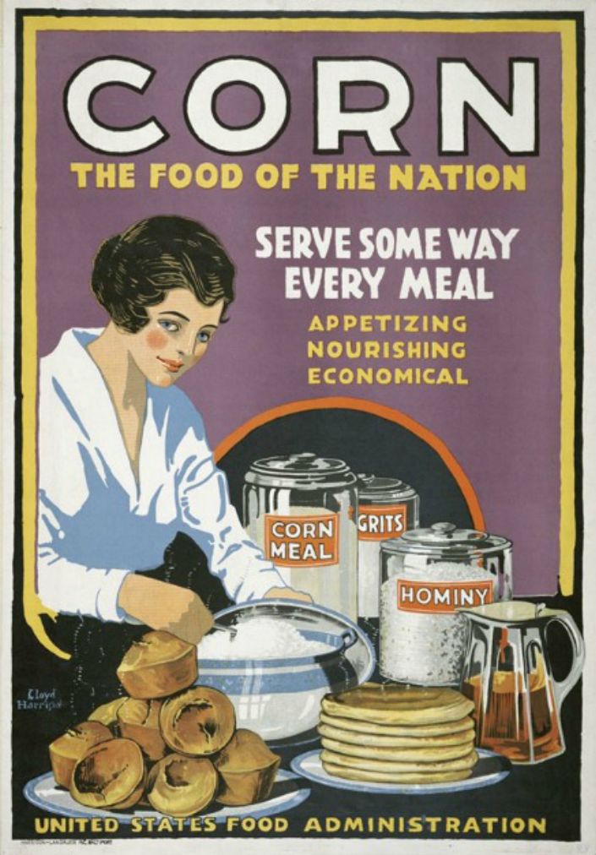
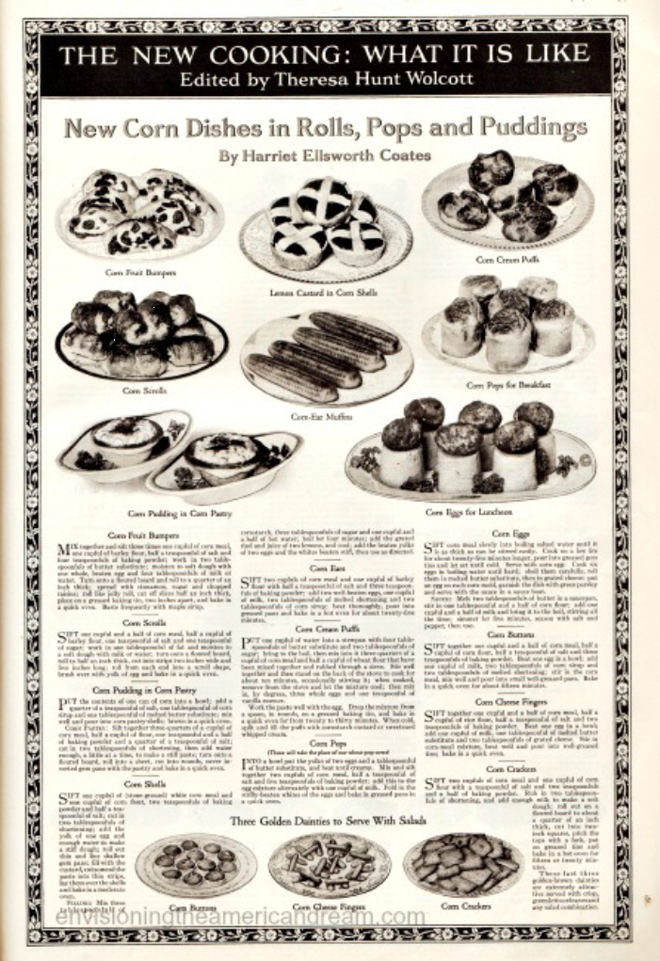
Notes:
Propaganda posters

Slide 6
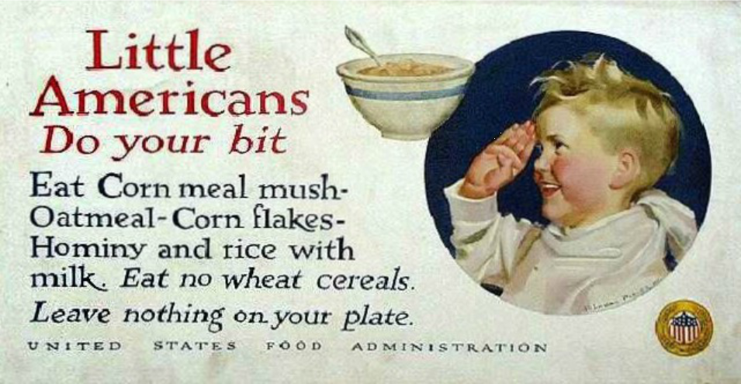
Notes:
Some aimed at kids

Slide 7
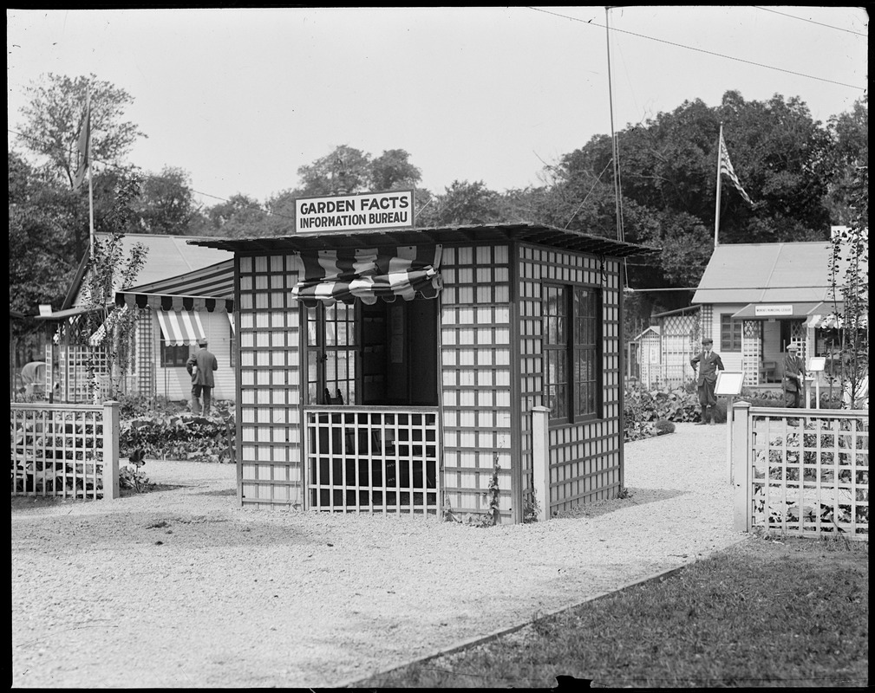
Notes:
What does this have to do with the Common?

Slide 8
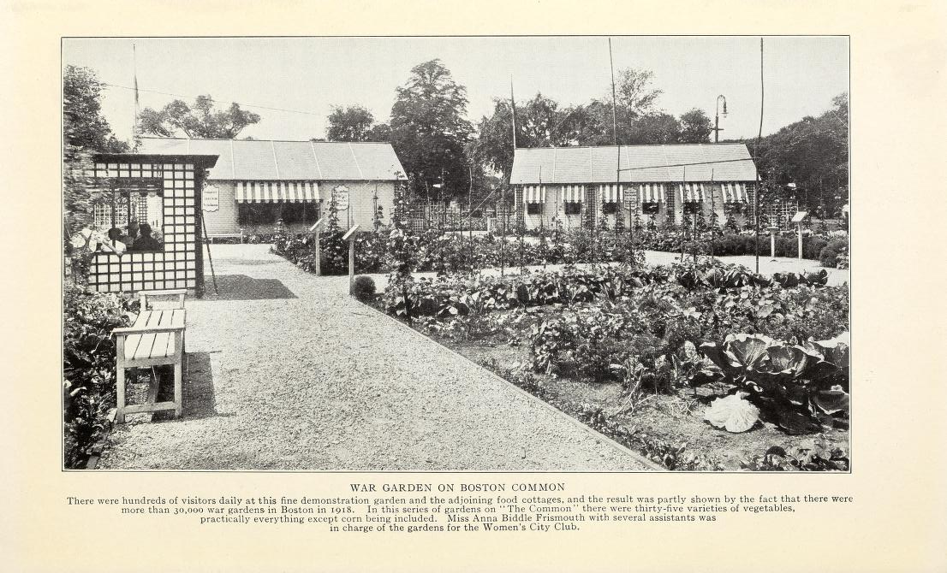
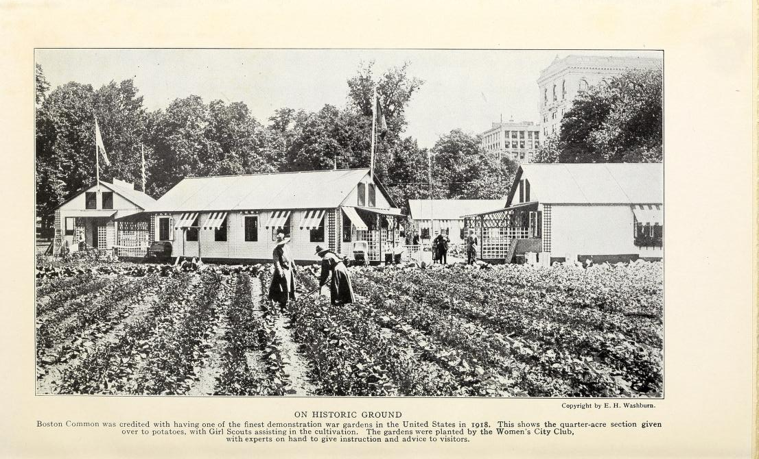
Notes:
Demonstration garden

Slide 9
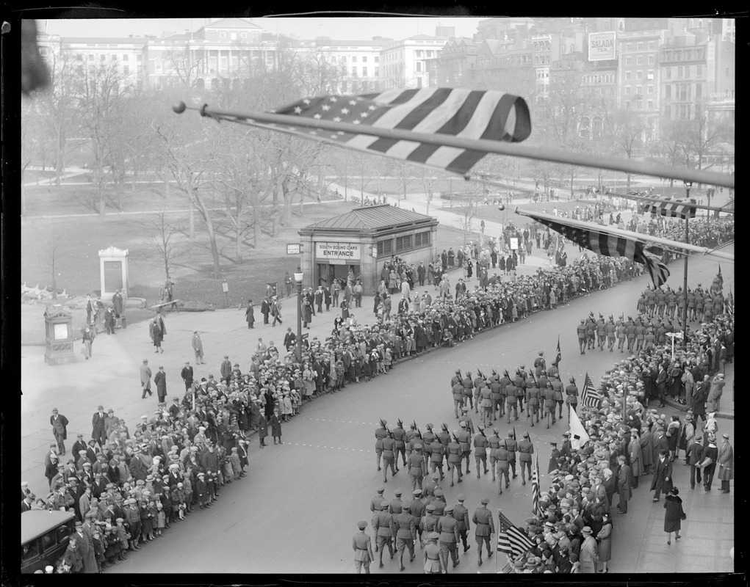
Notes:
End of WWI Armistice Day parade on Tremont Street, 1929. Now known as Veteran’s Day

Slide 11
World War II
Rationing becomes law

Slide 12
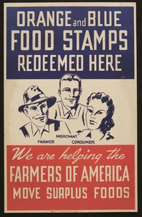
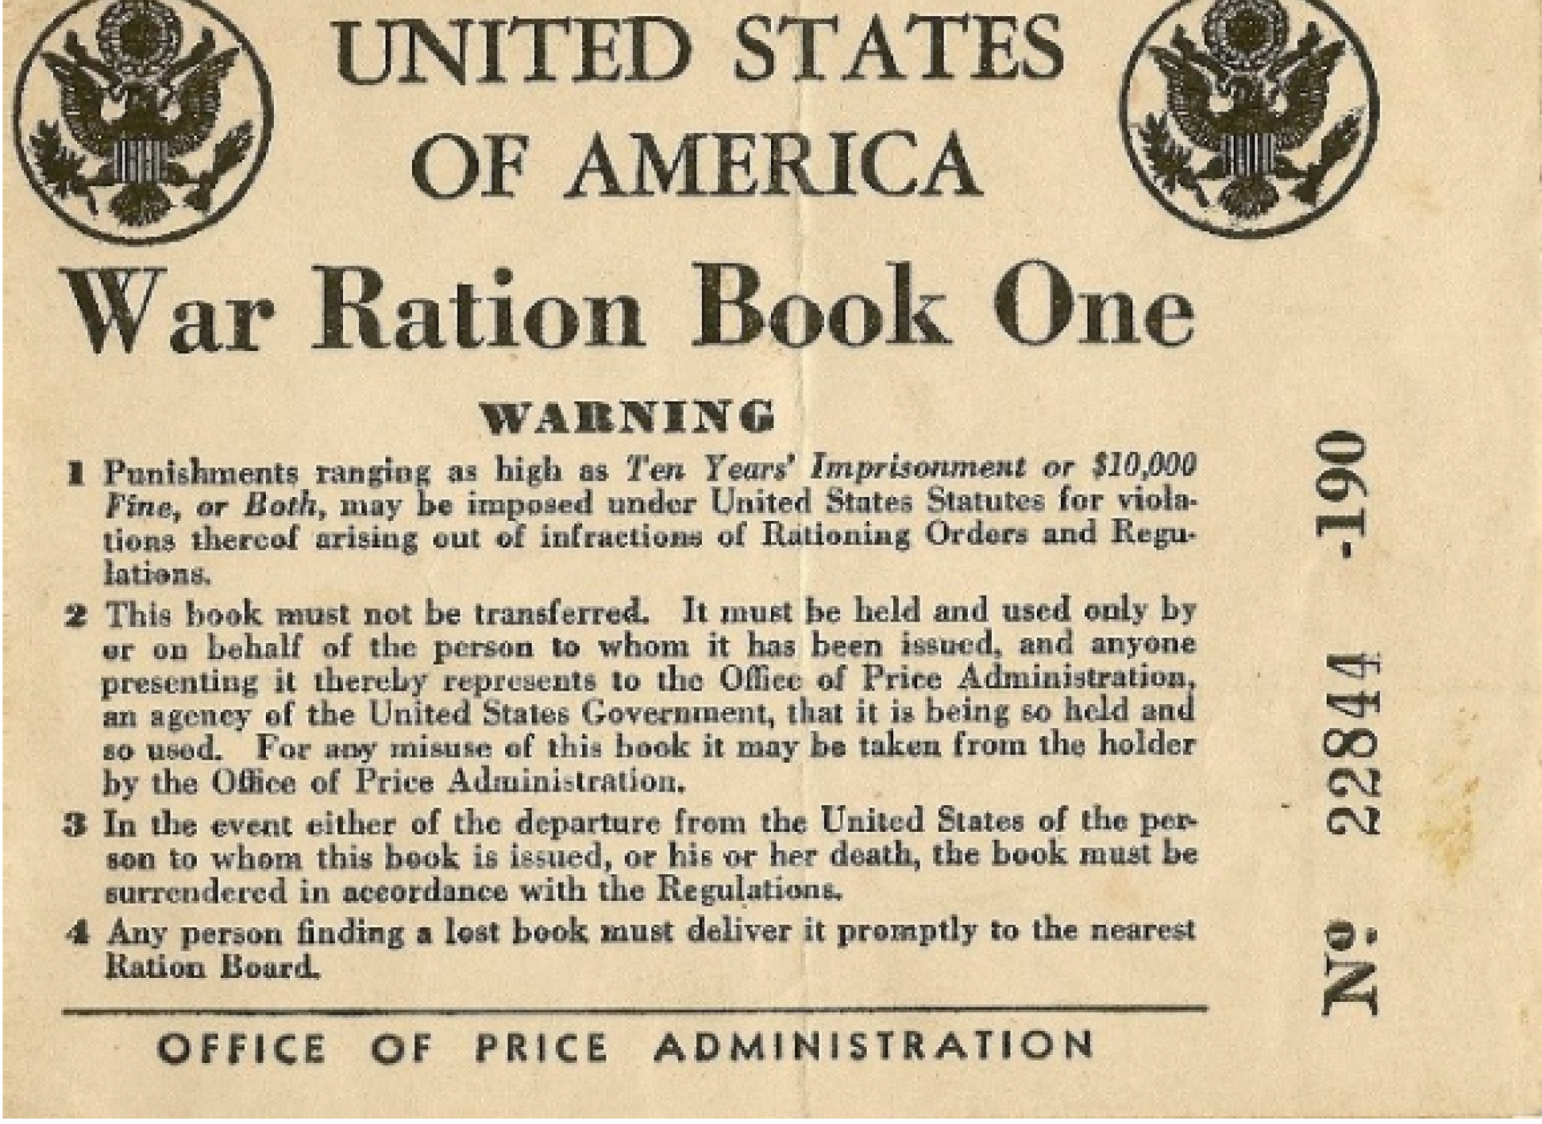
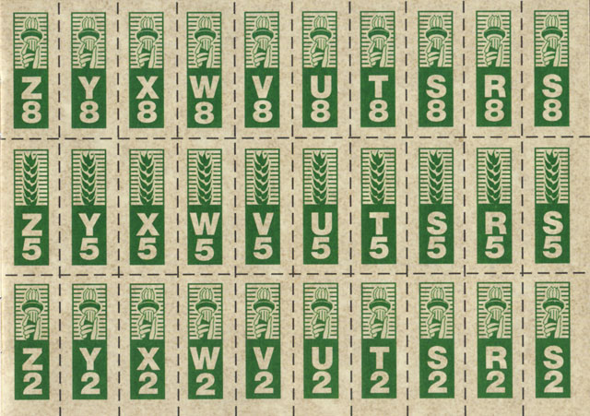
Notes:
WWI – all voluntary. WWII - rationing

Slide 13
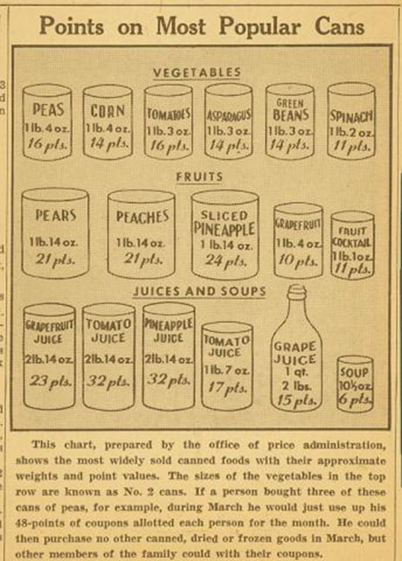

Slide 14
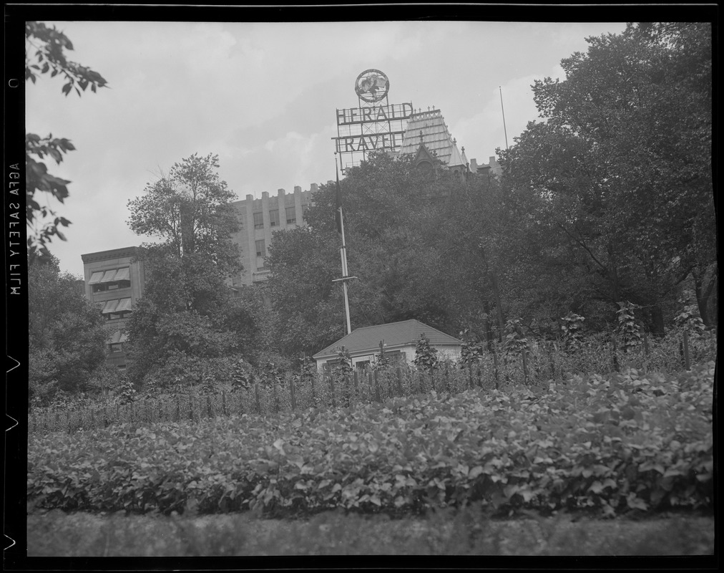

Slide 15
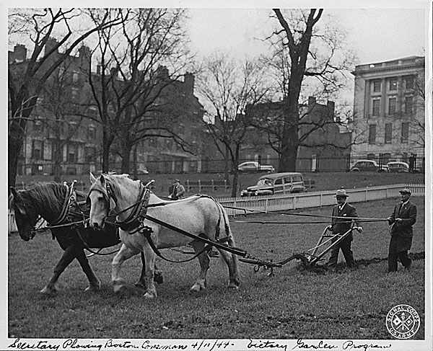
Notes:
Also used in WWII

Slide 16
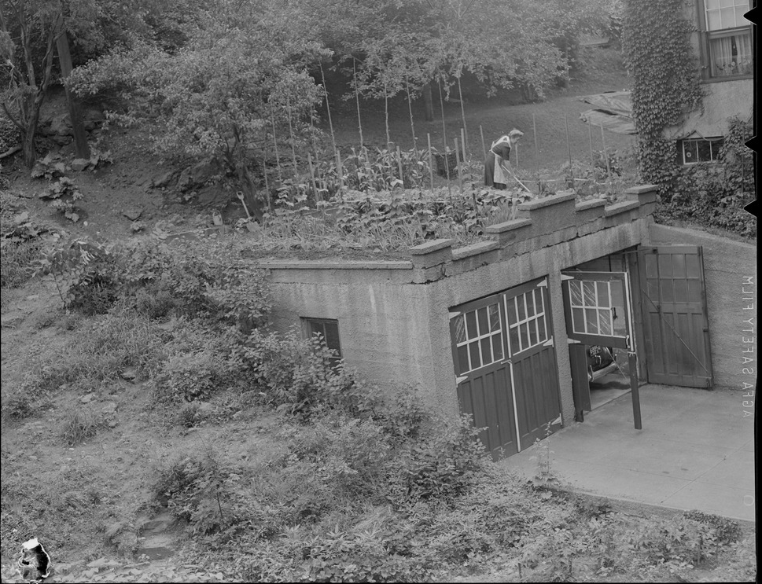
Notes:
WWII – on a garage, big one in Franklin Park

Slide 17
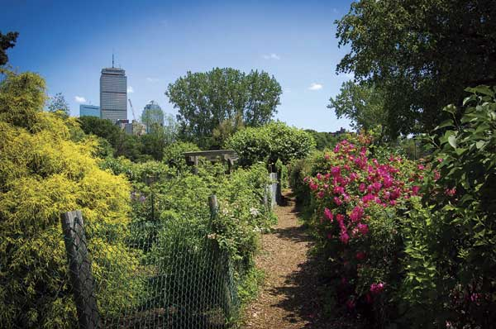
Notes:
Fenway Victory Garden

Slide 18
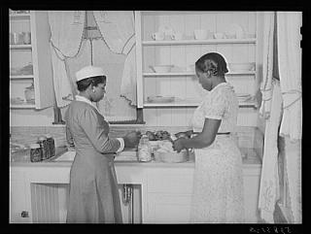
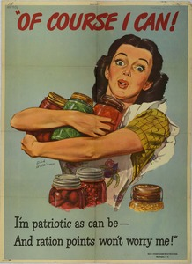
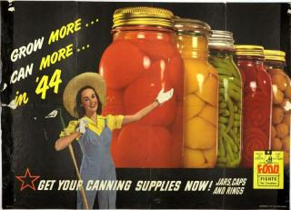
Notes:
canning

Slide 19
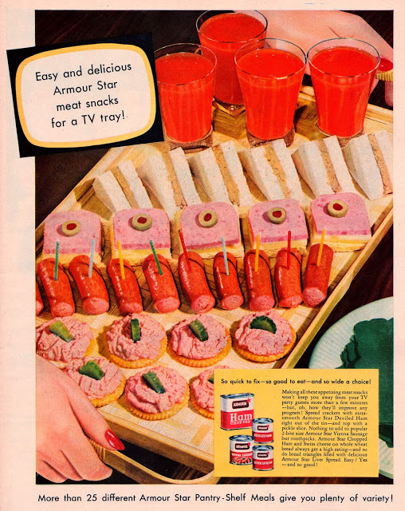
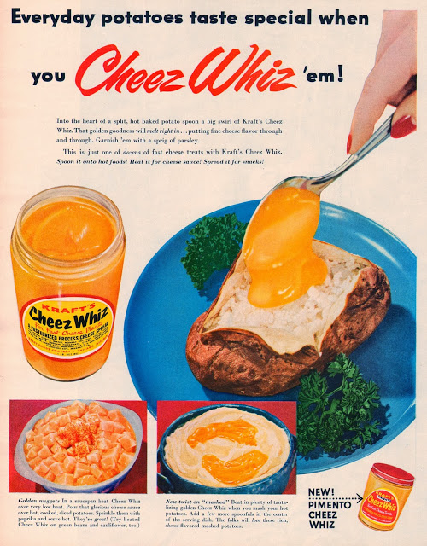
Notes:
After WW2, greater reliance on packaged and processed foods

Slide 20
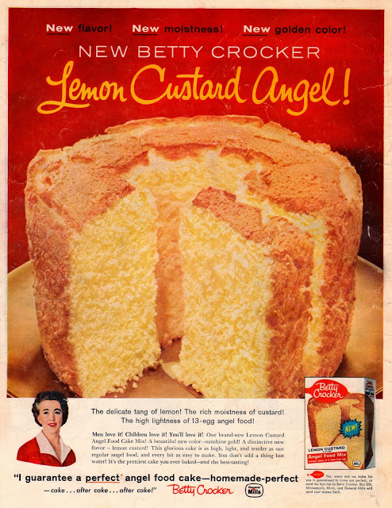
Notes:
More convenience food

Slide 21
Today
COVID-19, Food Insecurity, and the Modern Victory Garden

Slide 22
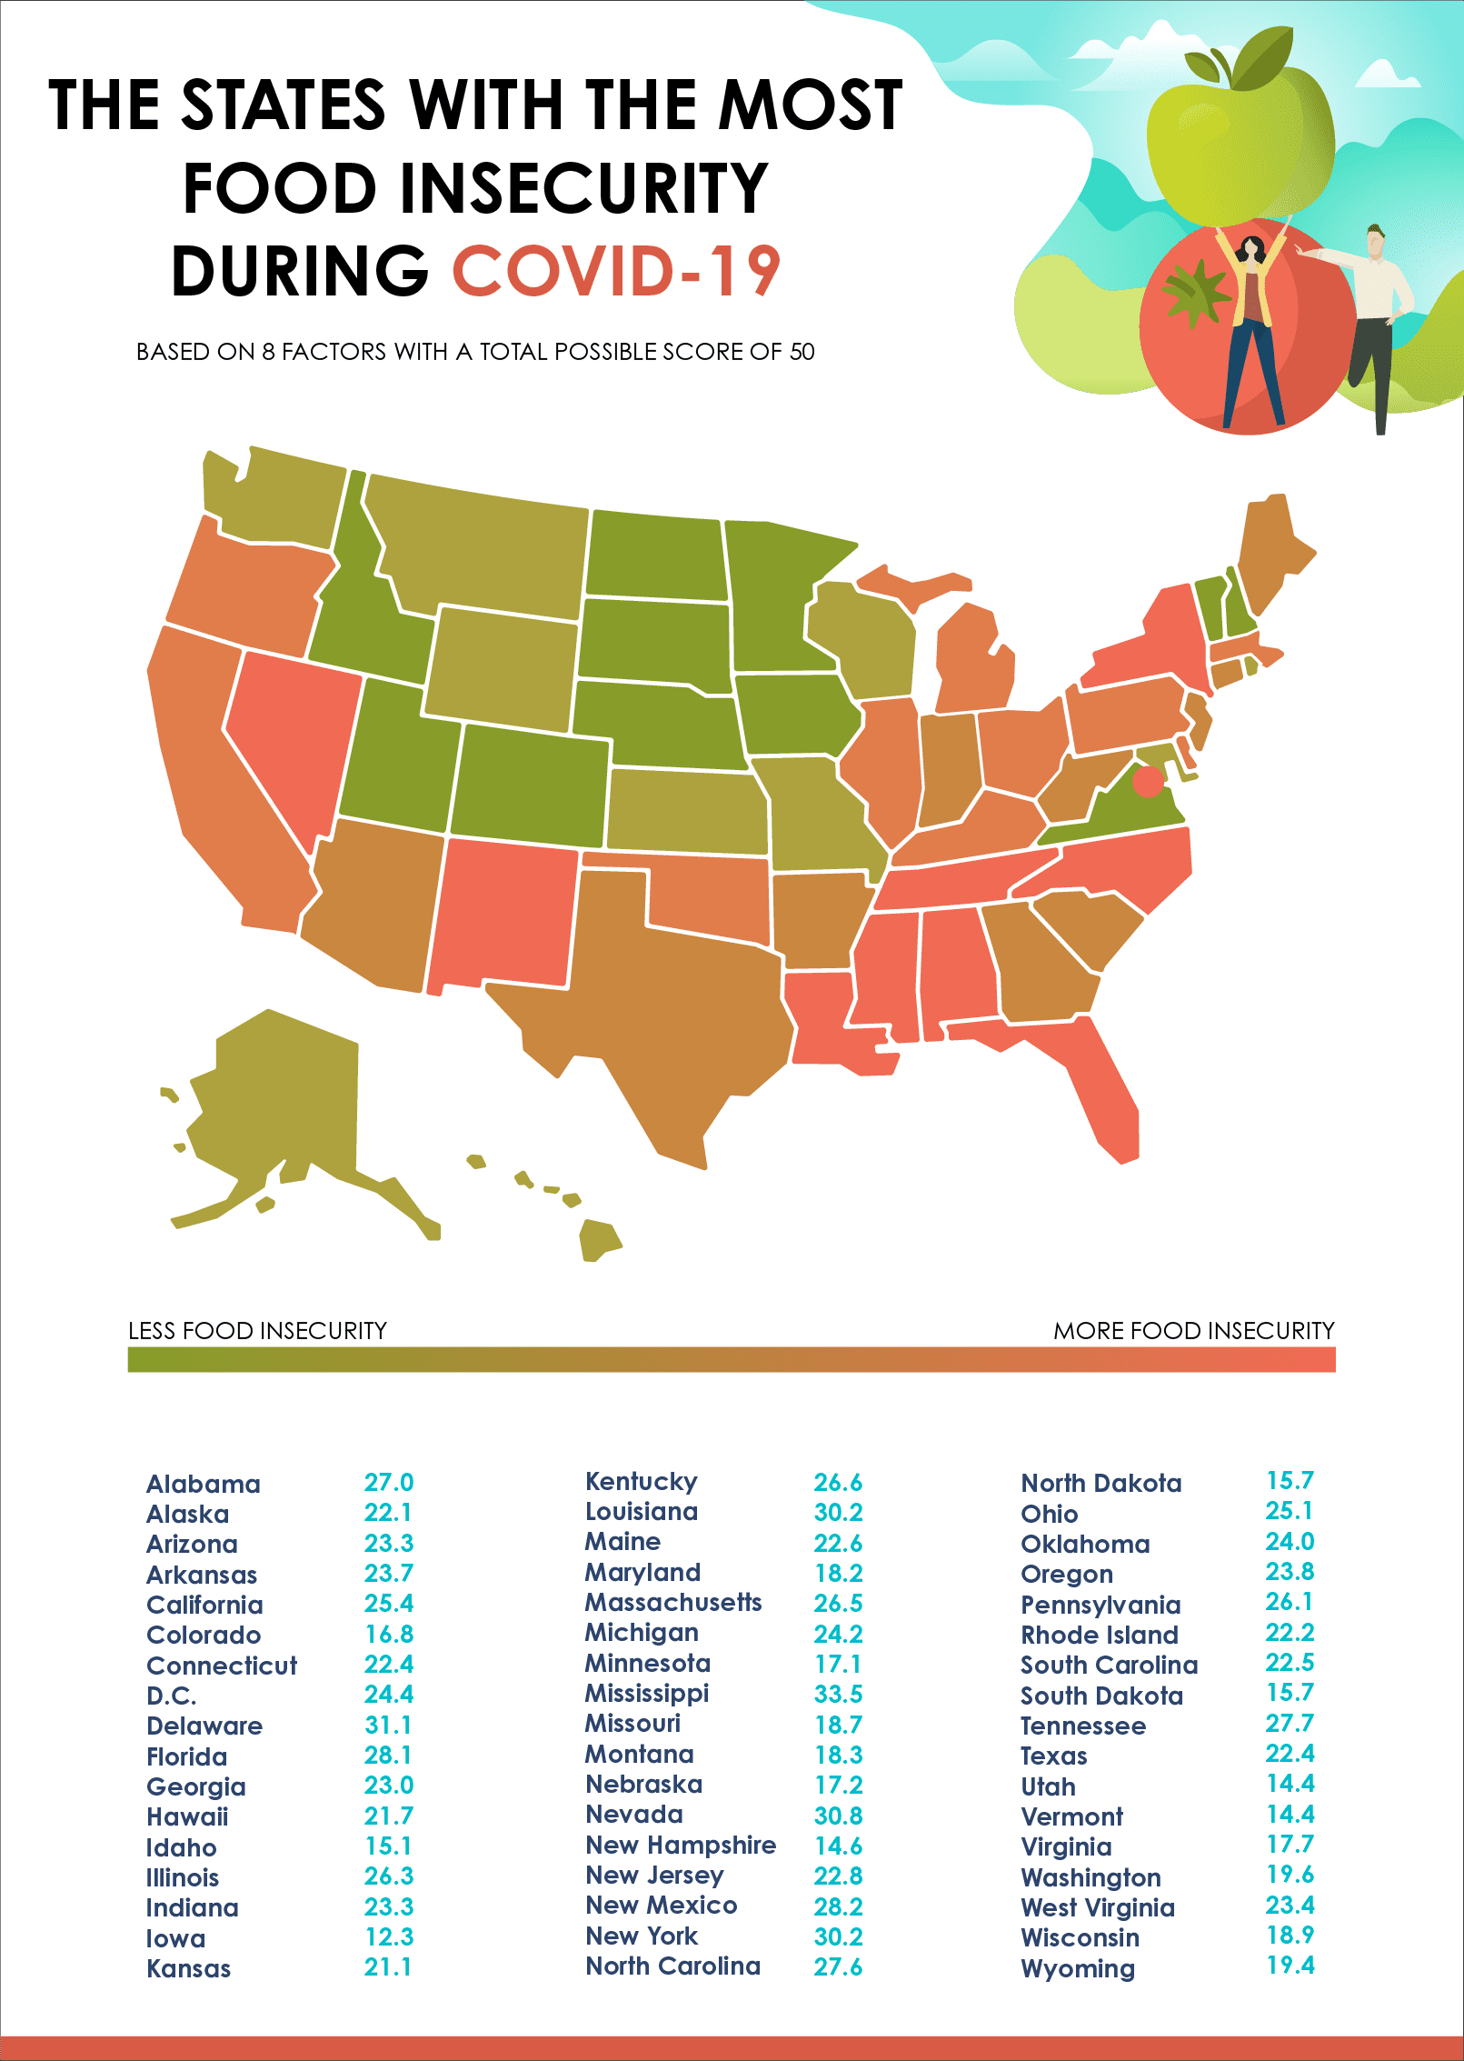
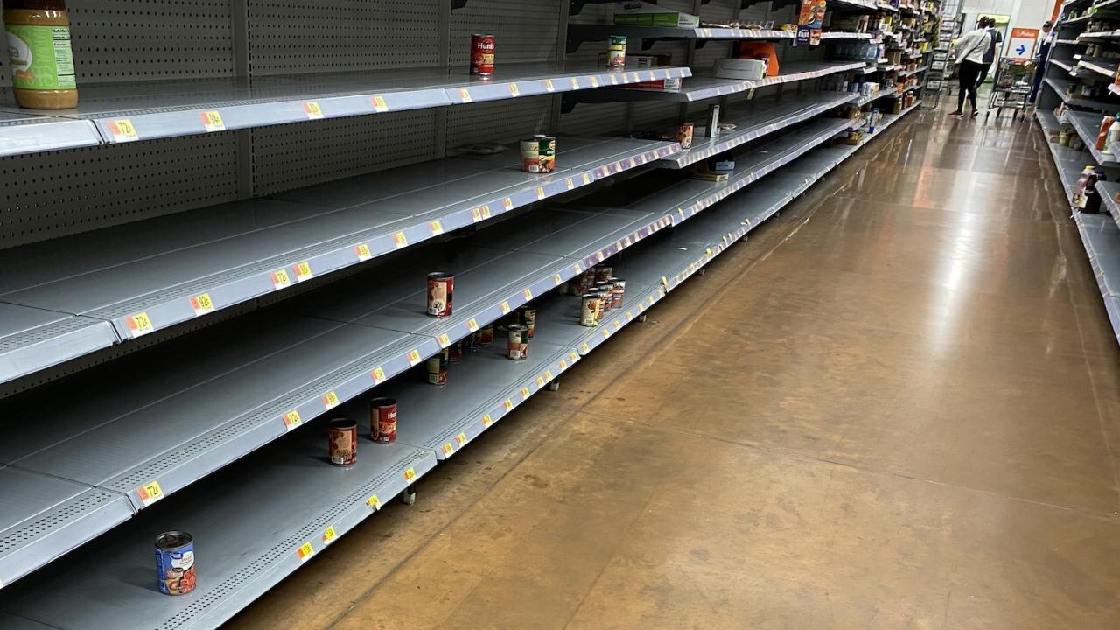
Notes:
Food insecurity during COVID

Slide 23
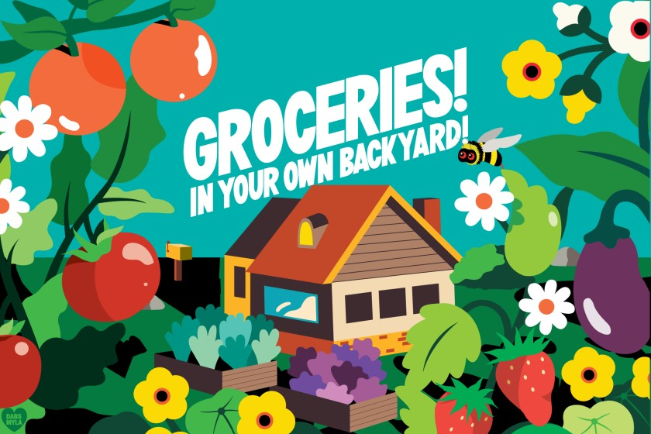
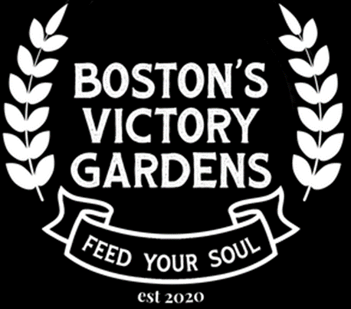
Notes:
Victory gardens today

Slide 24
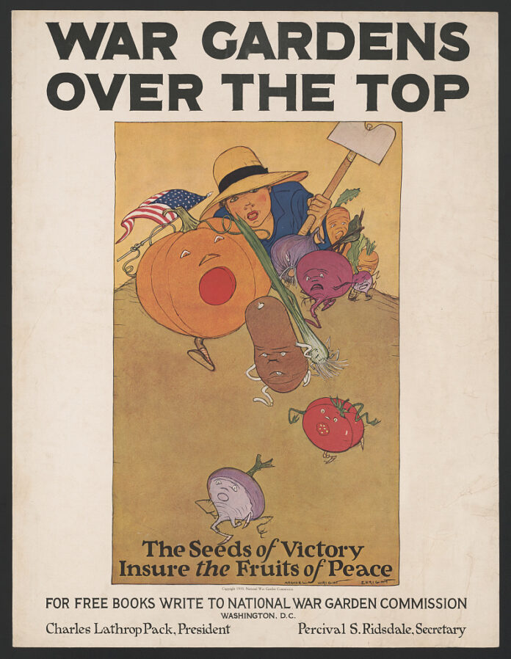
*Please note, images in this slide show are either in the public domain or are shared for educational use only. Neither Historic New England nor Friends on the Public Garden hold the copyright on these images.

